Slide 1
Challenges in Interpreting HEU Child and Adolescent Research to Drive Health Policy

Slide 2
Disclosures
I have no conflicts of interests

Slide 3
Presentation Scope
Review the contextual nature of “exposure” among HIV-exposed uninfected children
Review UNAIDS 2018 HEU child and adolescent population estimates
Review challenges in HEU child research

Slide 4
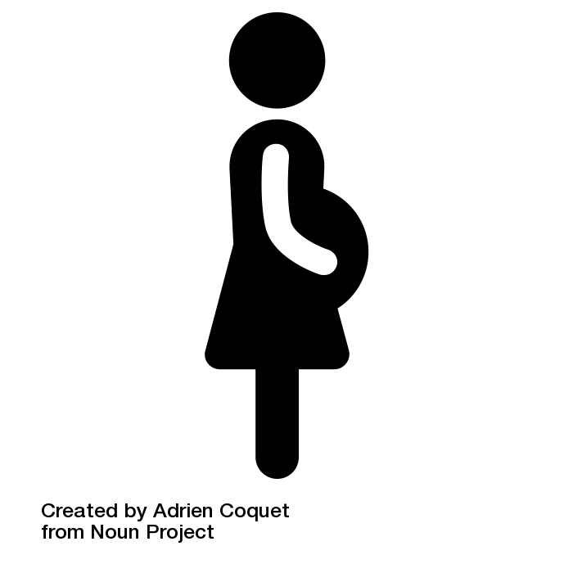
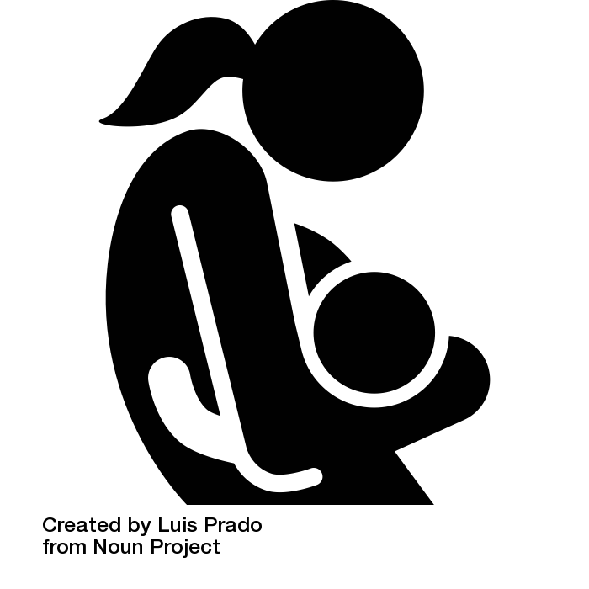
Variations in HIV and ARV Exposure Status
Varied timing and intensity of exposure to HIV viral particles
HIV Exposure
Varied timing and type of ARV exposure
Antriretroviral Exposure
Notes:
HEU children have differing HIV viral exposure during gestation. For example, some HEU infants are born to women who enter pregnancy virally suppressed while others are exposed to incident HIV infection in utero.
Our current HEU adolescents are less likely to have been exposed to triple ARVs in utero compared with an infant born in the last year.
An infant born in the last year is likely to be exposed to a significantly different ARV regimen than an infant born 5 years ago, as more ARV options emerge.

Slide 5

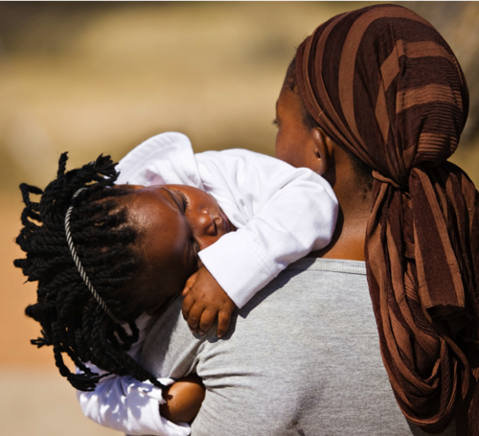
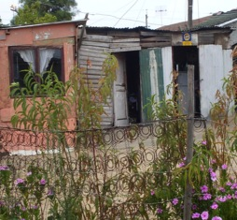
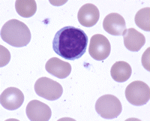
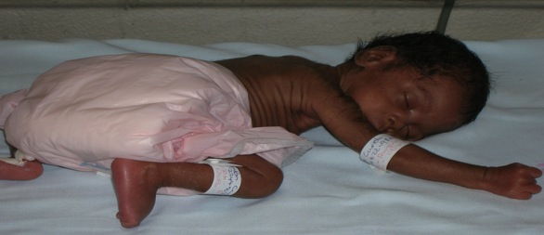
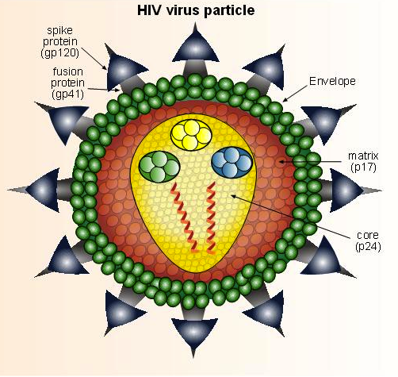
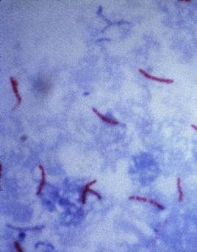
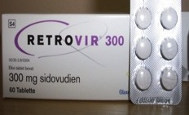
Universal Risk Factors
Unique HEU Infant Risk Factors
Notes:
Putting this together, is HEU infant risk for infectious morbidity mediated primarily through the universal infant pathways to infectious morbidity, or do the HEU-unique exposures play a role?

Slide 6
Data Source: UNADIS 2018

Slide 7
7.0 million HEU Children
Data Source: UNADIS 2018

Slide 8
14.8 million HEU Children
7.0 million HEU Children
Data Source: UNADIS 2018

Slide 9
14.8 million HEU Children
7.0 million HEU Children
Data Source: UNADIS 2018

Slide 10

Data Source: UNAIDS 2018

Slide 11
Data Source: UNADIS 2018
Source: UNAIDS 2018

Slide 12
Objective: To evaluate for selection bias
Methods: Simulated a cohort of 1,000 women living with HIV (WLHIV) recruited into a trial before conception, evaluating rates of preterm birth by timing of ART initiation.
Intention to Treat | As Treated
Preterm Category | Exposure Category | N (%) | Average RR (95% CI) | N % | Average RR (95% CI)
<37 weeks | Preconception During Pregnancy Excluded | 174 (34.7%) 175 (35.1%) ----- | 0.99 (0.84, 1.17) 1 ----- | 174 (34.7%) 144 (31.7%) 31 (69.8%) | 1.10 (0.92, 1.32) 1 -----
<32 weeks | Preconception During Pregnancy Excluded | 33 (6.6%) 34 (6.7%) ----- | 0.98 (0.61, 1.57) 1 ----- | 33 (6.6%) 21 (4.7%) 12 (27.3%) | 1.41 (0.82, 2.42) 1 -----
<28 weeks | Preconception During Pregnancy Excluded | 8 (1.5%) 8 (1.6%) ----- | 0.95 (0.32, 2.79) 1 ----- | 8 (1.5%) 4 (0.8%) 4 (9.3%) | 5.01 (1.35, 18.54) 1 -----
Stoner et al. Epidemiology 2018;29:224-229

Slide 13
Objective: To evaluate for selection bias
Methods: Simulated a cohort of 1,000 women living with HIV (WLHIV) recruited into a trial before conception, evaluating rates of preterm birth by timing of ART initiation.
Intention to Treat | As Treated
Preterm Category | Exposure Category | N (%) | Average RR (95% CI) | N % | Average RR (95% CI)
<37 weeks | Preconception During Pregnancy Excluded | 174 (34.7%) 175 (35.1%) ----- | 0.99 (0.84, 1.17) 1 ----- | 174 (34.7%) 144 (31.7%) 31 (69.8%) | 1.10 (0.92, 1.32) 1 -----
<32 weeks | Preconception During Pregnancy Excluded | 33 (6.6%) 34 (6.7%) ----- | 0.98 (0.61, 1.57) 1 ----- | 33 (6.6%) 21 (4.7%) 12 (27.3%) | 1.41 (0.82, 2.42) 1 -----
<28 weeks | Preconception During Pregnancy Excluded | 8 (1.5%) 8 (1.6%) ----- | 0.95 (0.32, 2.79) 1 ----- | 8 (1.5%) 4 (0.8%) 4 (9.3%) | 5.01 (1.35, 18.54) 1 -----
Stoner et al. Epidemiology 2018;29:224-229

Slide 14
Objective: To evaluate for selection bias
Methods: Simulated a cohort of 1,000 women living with HIV (WLHIV) recruited into a trial before conception, evaluating rates of preterm birth by timing of ART initiation.
Intention to Treat | As Treated
Preterm Category | Exposure Category | N (%) | Average RR (95% CI) | N % | Average RR (95% CI)
<37 weeks | Preconception During Pregnancy Excluded | 174 (34.7%) 175 (35.1%) ----- | 0.99 (0.84, 1.17) 1 ----- | 174 (34.7%) 144 (31.7%) 31 (69.8%) | 1.10 (0.92, 1.32) 1 -----
<32 weeks | Preconception During Pregnancy Excluded | 33 (6.6%) 34 (6.7%) ----- | 0.98 (0.61, 1.57) 1 ----- | 33 (6.6%) 21 (4.7%) 12 (27.3%) | 1.41 (0.82, 2.42) 1 -----
<28 weeks | Preconception During Pregnancy Excluded | 8 (1.5%) 8 (1.6%) ----- | 0.95 (0.32, 2.79) 1 ----- | 8 (1.5%) 4 (0.8%) 4 (9.3%) | 5.01 (1.35, 18.54) 1 -----
Stoner et al. Epidemiology 2018;29:224-229

Slide 15

Infant HIV-Free Survival in the Era of Universal Antiretroviral Therapy for Pregnant and Breastfeeding Women: A Community-Based Cohort Study from Rural Zambia
Chi BH, Mutale W, Winston J, Phiri W, Price JT, Mwiche A, Ayles H, Stringer JSA.
STUDY DESIGN
To assess impact of Option B+ on HIV-free Infant Survival
Prospective enrollment of mother-infant pairs in 33 peri-urban and rural communities in Lusaka, Zambia
Women living with HIV and their HEU infants could enroll if the infant was ≤ 30 days old.
RESULTS
Enrolled 827 mother-infant pairs between June 2014 and November 2015.
36 (4.4%) LTFU or withdrew
23 (2.8%) infants died
22 (3.0%) infants acquired HIV
Chi et al PIDJ Published ahead of print
Notes:
The communities were participating in the Better Health Outcomes through Mentoring and Assessment project, an initiative to improve the quality of primary care through community- and facility-based interventions.
Nearly 80% with institutional delivery.
99.4% breastfeeding at enrollment; 98.1% (95% CI 96.8-98.9) at 6 weeks, 97.8% (96.5-98.6) at 6 months and 84.8% (81.9-87.4) at 12 months.
The authors did not report on the prevalence birth, nor report on the average time of enrollment. Since mother-infant pairs could enroll up to 30 days after the infant’s birth, these results may not reflect neonatal deaths, but they are reassuring.
87.6% of women report ART use at enrollment; 85.7 (83.2-88) at 6 weeks; 82.6% (79.8-85.1) at 6 months; 80.5% (77.7-83.2) at 12 months.

Slide 16
Infant HIV-Free Survival in the Era of Universal Antiretroviral Therapy for Pregnant and Breastfeeding Women: A Community-Based Cohort Study from Rural Zambia
Chi BH, Mutale W, Winston J, Phiri W, Price JT, Mwiche A, Ayles H, Stringer JSA.
Table 1: Kaplan-Meier Pooled Analysis of Infant Outcomes
 | 6 weeks | 6 months | 12 months | P-value
Overall HIV- Free Survival | 99.0% (98.0-99.5) | 97.5% (96.1-98.4) | 96.3% (94.8-97-4) | ----
HIV-Free Survival by Maternal ART Use Use of ART (N=724) No ART (N=103) | 99.1% (98.1-99.6) 97.9% (91.7-99.5) | 98.1% (96.8-98.9) 92.4% (84.7-96.3) | 97.4% (95.9-98.4) 89.0% (80.6-94.0) | <0.01
Chi et al PIDJ Published ahead of print
Notes:
The communities were participating in the Better Health Outcomes through Mentoring and Assessment project, an initiative to improve the quality of primary care through community- and facility-based interventions.
Nearly 80% with institutional delivery.
99.4% breastfeeding at enrollment; 98.1% (95% CI 96.8-98.9) at 6 weeks, 97.8% (96.5-98.6) at 6 months and 84.8% (81.9-87.4) at 12 months.
The authors did not report on the prevalence preterm birth, nor report on the average time of enrollment. Since mother-infant pairs could enroll up to 30 days after the infant’s birth, these results may not reflect neonatal deaths, but they are reassuring.
87.6% of women report ART use at enrollment; 85.7 (83.2-88) at 6 weeks; 82.6% (79.8-85.1) at 6 months; 80.5% (77.7-83.2) at 12 months.

Slide 17
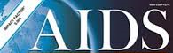
Maternal HIV infection is an important health determinant in non-HIV-infected infants
Rupérez M, González R, Maculuve S, Quintó L, López-Varela E, Augusto O, Vala A, Nhacolo A, Sevene E, Naniche D, Menéndez C.
Study Design
Assess infant morbidity/mortality
Prospectively collected data from
  966 HEU infants born from Jan 2010 to Dec 2013 from High-Risk Pediatric Outpatient Clinics
  909 HUU infants born from Feb 2010 to Oct 2012 from malaria study
Information collected on outpatient sick visits and hospital admissions through age 18 months
Rupérez et al, AIDS 2017;31:1545-1553.
Notes:
Mothers of HUUs participated in mefloquine with sulphadoxine-pyrimethamine RCT to evaluate intermittent preventative malaria in pregnancy. Results showed no difference in morbidity, mortality or nutritional status of HUU infants by arm.
Option B+ adopted in Mozambique in 2013. (EFV-TDF)-3TC. Prior to that, ART with NVP or EFV + 3TC/CBV or stavudine (d4T)
All HEUs were supposed to attend H-RPOCs and mother-infant pairs consented at 1 month of life for study passive study participation.

Slide 18
Maternal HIV infection is an important health determinant in non-HIV-infected infants
Rupérez M, González R, Maculuve S, Quintó L, López-Varela E, Augusto O, Vala A, Nhacolo A, Sevene E, Naniche D, Menéndez C.
HIV-Exposed Uninfected Children
Age | Mortality Rate (95% CI) | Hazard Ratio (95% CI) | P-value
0 to < 1 month | 2.67 (0.67, 10.66) | 1 | 0.02
1 to < 6 months | 4.94 (3.07, 7.94) | 1.92 (0.43, 8.51)
6 to <12 months | 1.22 (0.51, 2.93) | 0.55 (0.11, 2.82)
12 to ≤ 18 months | 0.76 (0.24, 2.34) | 0.47 (0.08, 2.62)
Total | 2.20 (1.51, 3.21) | -----
HIV-Unexposed Uninfected Children
Age | Mortality Rate (95% CI) | Hazard Ratio (95% CI) | P-value
0 to < 1 month | 5.28 (1.98, 14.07) | 1 | 0.03
1 to < 6 months | 1.67 (0.75, 3.72) | 0.25 (0.07, 0.94)
6 to <12 months | 0.92 (0.35, 2.46) | 0.12 (0.03, 0.57)
12 to ≤ 18 months | 0.24 (0.03, 1.69) | 0.04 (0.00, 0.51)
Total | 1.16 (0.70, 1.93) | -----
Rupérez et al, AIDS 2017;31:1545-1553.
Notes:
Mothers of HUUs participated in mefloquine with sulphadoxine-pyrimethamine RCT to evaluate intermittent preventative malaria in pregnancy. Results showed no difference in morbidity, mortality or nutritional status of HUU infants by arm.
Option B+ adopted in Mozambique in 2013. (EFV-TDF)-3TC. Prior to that, ART with NVP or EFV + 3TC/CBV or stavudine (d4T)
All HEUs were supposed to attend H-RPOCs and mother-infant pairs consented at 1 month of life for study passive study participation.

Slide 19
Maternal HIV infection is an important health determinant in non-HIV-infected infants
Rupérez M, González R, Maculuve S, Quintó L, López-Varela E, Augusto O, Vala A, Nhacolo A, Sevene E, Naniche D, Menéndez C.
Risk Factors for Hospital Admissions among HEU Children through 18 Months of Life in Multivariate Analysis
Covariate | N | IRR | 95% CI | P-value
Age 0 to < 1 month 1 to < 6 months 6 to < 12 months 12 to ≤ 18 months | 909 | 1 0.37 0.24 0.13 | (0.09, 1.52) (0.01, 1.05) (0.03, 0.64) | 0.05
Breastfeeding Exclusive Partial Weaned Never Breastfed | 684 | 1 2.21 6.74 2.63 | (0.70, 6.99) (1.87, 24.31) (0.92, 7.52) | 0.02
Maternal Triple ART No Yes | 684 | 1 1.37 | (0.51, 3.70) | 0.54
Rupérez et al, AIDS 2017;31:1545-1553.
Notes:
Limitations:
Period of study crosses a period where maternal ART was used for advanced HIV disease and then transition of Option B+
HUU infants were followed in a controlled study setting where HEU infants were passively followed, with significantly higher incidence of missing data
HUU infant feeding practices was not recorded preventing comparison of this covariate between HEU and HUU infants.
¹After adjustment for child sex, birth weight, mode of delivery, location of delivery, gestational age at birth, maternal or child use of cotrimoxazole, child ARV prophylaxis.

Slide 20
Weight gain of HIV-exposed, uninfected children before and after introduction of ‘Option B⁺’ programme in Malawi
Msukwa MT, Estill J, Haas AD, van Oosterhour JJ, Tenthani L, Davies M-A, Tal K, Phiri N, Spoerri A, Mthiko BC, Chimbwandira F, Keiser O.
Study Design
Infants born to women living with HIV enrolled in one of 21 HIV Care Clinics (HCCs) in Central and Southern Malawi between Feb 2010 and May 2015
Infant/child weights recorded at each HCC visit
Defined pre-Option B+ or Option B+ timing by date a health facility adopted Option B+
6,845 HEU infants eligible for study inclusion, 6,061 (89%) born in the Option B+ era
Msukwa M et al, AIDS In Press.

Slide 21
Weight gain of HIV-exposed, uninfected children before and after introduction of ‘Option B⁺’ programme in Malawi
Msukwa MT, Estill J, Haas AD, van Oosterhour JJ, Tenthani L, Davies M-A, Tal K, Phiri N, Spoerri A, Mthiko BC, Chimbwandira F, Keiser O.
Weight-for-Age Z-Score
Msukwa M et al, AIDS In Press.

Slide 22
Weight gain of HIV-exposed, uninfected children before and after introduction of ‘Option B⁺’ programme in Malawi
Msukwa MT, Estill J, Haas AD, van Oosterhour JJ, Tenthani L, Davies M-A, Tal K, Phiri N, Spoerri A, Mthiko BC, Chimbwandira F, Keiser O.
Study Limitations
48.3% of HEU infants/child in Pre-Option B+ and 31.5% in the Option B+ eras were lost to follow-up
Median age at enrollment was 4 months and 2 months respectively in the pre-Option B+ and Option B+ eras
Could not exclude temporal differences in poverty, socio-economic conditions, or child nutritional status having an influence on observed differences in weight gain
Weight-for-Age Z-Score
Msukwa M et al, AIDS In Press.

Slide 23

Neurodevelopment in Young Children Born to HIV-Infected Mothers: A Meta-analysis
Megan S. McHenry, MD, MS, a, b Carole I. McAteer, MS, a, b Eren Oyungu, MBChB, MMED, c Brenna C. McDonald, PsyD,
MBA, ABPP-CN, d Chris B. Bosma, BS, a Philani B. Mpofu, BS, e Andrew R. Deathe, BS, a Rachel C. Vreeman, MD, MSa, b, c
Estimated Means and 95% Confidence Intervals of the Bayley Scales of Infant and Toddler Development by HIV Exposure Group
Outcome | Group | Estimate | 95% Confidence Interval
 |  |  | Lower | Upper
Mental Developmental Index | HUU (n=153) HEU (n=1,231) CLHIV (n=367) | 89.79 83.03 73.38 | 78.78 75.73 66.87 | 101.07 90.99 80.29
Psychomotor Developmental Index | HUU (n=153) HEU (n=1,230) CLHIV (n=365) | 99.01 94.85 81.53 | 87.21 87.16 74.66 | 111.06 103.23 88.70
McHenry et al Pediatrics 2018;141:e20172888
Notes:
Studies have shown that working memory, processing speed, and executive function are domains most affected by HIV in older children and adolescents and while there has been limited studies evaluating this in HEU older children and adolescents, in part because once a HEU child is confirmed uninfected routine health and educational systems in the highest burden HIV settings do not track their HIV exposure status.
McHenry and colleagues performed a systematic review and meta-analyses evaluated published neurodevelopmental studies that included at least two of the populations of interest, HIV+, HEU or HUU involving children < 8 years of age, given UNICEF’s definition of early childhood, a period where the brain experiences it most rapid development and a period where interventions have been shown to alter outcomes. The systematic review included published studies between January 1990 and January 2017.
46 studies were identified, 25 studies included an HEU population.
45 studies of which 25 included HEU child neurodevelopmental outcomes
Metanalysis included 12 studies (6 from US, 5 from sub Saharan Africa and 1 from South America): All US studies were rated as high quality whereas the ones in Subsaharan Africa and South America were rated as low quality with no documentation of maternal IVDU.
Normative group for the Bayley Scales of Infant and Toddler Development has a mean score of 100 with a SD of 15.

Slide 24
Neurodevelopment in Young Children Born to HIV-Infected Mothers: A Meta-analysis
Megan S. McHenry, MD, MS, a, b Carole I. McAteer, MS, a, b Eren Oyungu, MBChB, MMED, c Brenna C. McDonald, PsyD,
MBA, ABPP-CN, d Chris B. Bosma, BS, a Philani B. Mpofu, BS, e Andrew R. Deathe, BS, a Rachel C. Vreeman, MD, MSa, b, c
Comparison of ARV Exposure by Child Exposure Group
McHenry et al Pediatrics 2018;141:e20172888
Notes:
When the authors evaluated Bayley Mental Developmental Index scores and Psychomotor Developmental Index Scores by ARV exposure and HIV exposure, we can see that ARV exposure was associated with lower mean indices among HEU children. The authors were very clear

Slide 25
Neurodevelopment in Young Children Born to HIV-Infected Mothers: A Meta-analysis
Megan S. McHenry, MD, MS, a, b Carole I. McAteer, MS, a, b Eren Oyungu, MBChB, MMED, c Brenna C. McDonald, PsyD,
MBA, ABPP-CN, d Chris B. Bosma, BS, a Philani B. Mpofu, BS, e Andrew R. Deathe, BS, a Rachel C. Vreeman, MD, MSa, b, c
Comparison of ARV Exposure by Child Exposure Group
McHenry et al Pediatrics 2018;141:e20172888
Notes:
When the authors evaluated Bayley Mental Developmental Index scores and Psychomotor Developmental Index Scores by ARV exposure and HIV exposure, we can see that ARV exposure was associated with lower mean indices among HEU children. The authors were very clear

Slide 26
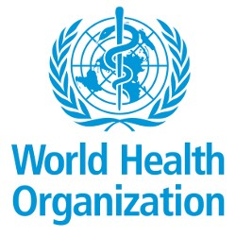
Potential Safety Issue Affecting Women Living with HIV Using Dolutegravir at the Time of Conception
18 May 2018
An NIH-funded birth outcomes surveillance study conducted in Botswana, which includes 45% of births in the country, has identified an early potential safety signal related to a possible elevated risk of neural tube defects in 426 women receiving DTG at the time of conception compared to more than 11,000 women receiving non-dolutegravir antiretroviral treatment at the time of conception and more than 66,000 HIV-uninfected women.

Slide 27
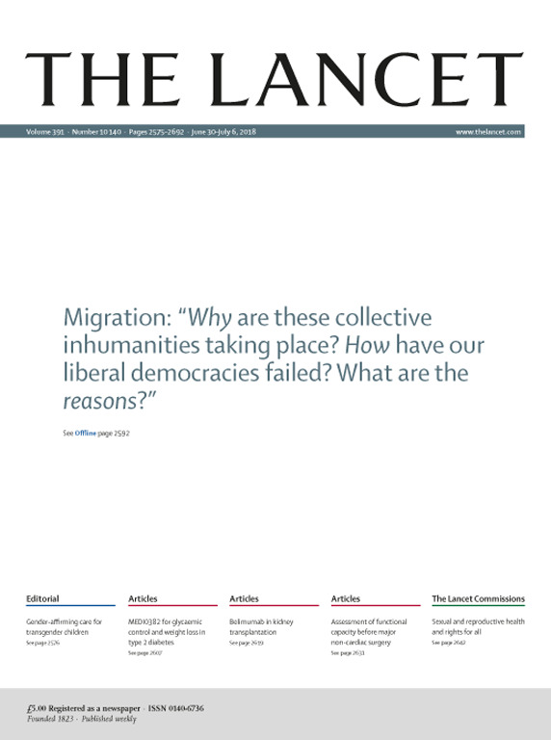
Potential Safety Issue Affecting Women Living with HIV Using Dolutegravir at the Time of Conception
18 May 2018
An NIH-funded birth outcomes surveillance study conducted in Botswana, which includes 45% of births in the country, has identified an early potential safety signal related to a possible elevated risk of neural tube defects in 426 women receiving DTG at the time of conception compared to more than 11,000 women receiving non-dolutegravir antiretroviral treatment at the time of conception and more than 66,000 HIV-uninfected women.
Dolutegravir for HIV: a lesson
in pregnancy safety research
Botswana study highlights the importance of pregnancy safety research. Systematic birth surveillance, both of livebirths and stillbirths, with sufficient power and appropriate comparator groups needs to be put in place before a new drug is rolled out.

Slide 28
Potential Safety Issue Affecting Women Living with HIV Using Dolutegravir at the Time of Conception
18 May 2018
An NIH-funded birth outcomes surveillance study conducted in Botswana, which includes 45% of births in the country, has identified an early potential safety signal related to a possible elevated risk of neural tube defects in 426 women receiving DTG at the time of conception compared to more than 11,000 women receiving non-dolutegravir antiretroviral treatment at the time of conception and more than 66,000 HIV-uninfected women.
……it's been clear ever since suppressive ART during pregnancy became standard of care that we could eliminate the risk of HIV transmission to the newborn.
But with that staggering success comes a responsibility, to determine the safest treatment for the uninfected baby.
Dr. Paul Sax
NEJM Journal Watch
Dolutegravir for HIV: a lesson
in pregnancy safety research
Botswana study highlights the importance of pregnancy safety research. Systematic birth surveillance, both of livebirths and stillbirths, with sufficient power and appropriate comparator groups needs to be put in place before a new drug is rolled out.

Slide 29
Potential Safety Issue Affecting Women Living with HIV Using Dolutegravir at the Time of Conception
18 May 2018
An NIH-funded birth outcomes surveillance study conducted in Botswana, which includes 45% of births in the country, has identified an early potential safety signal related to a possible elevated risk of neural tube defects in 426 women receiving DTG at the time of conception compared to more than 11,000 women receiving non-dolutegravir antiretroviral treatment at the time of conception and more than 66,000 HIV-uninfected women.
….although the benefits of treatment are clear, the crucial need for pharmacovigilance to assess for potential adverse effects of new agents, particularly on pregnancy outcome, birth defects, and exposed infants, has been relatively neglected.
Dr. Lynne Mofenson
Lancet Global Health
……it's been clear ever since suppressive ART during pregnancy became standard of care that we could eliminate the risk of HIV transmission to the newborn.
But with that staggering success comes a responsibility, to determine the safest treatment for the uninfected baby.
Dr. Paul Sax
NEJM Journal Watch
Dolutegravir for HIV: a lesson
in pregnancy safety research
Botswana study highlights the importance of pregnancy safety research. Systematic birth surveillance, both of livebirths and stillbirths, with sufficient power and appropriate comparator groups needs to be put in place before a new drug is rolled out.

Slide 30

Notes:
The Botswana preliminary findings regarding the concern for DTG use from conception being associated with neural tube defects highlight the elephant in the room. Maternal ARVs are needed to eliminate infant HIV acquisition. We do not want to lose ground on the goal of eliminating infant acquisition of HIV. We are challenged with how best to communicate signals such as the DTG signal to families living with HIV and healthcare workers in a manner that promotes the use ART to optimize a woman’s health in pregnancy and ensures that the infant does not acquire HIV. At the same time, monitoring systems and strategically coordinated well-conducted research are needed to identify the safest regimens in pregnancy and to identify mechanisms both biological and sociological for the disparities that the large and expanding population of HEU infants, children and adolescents are facing. And on that sobering note, I turn the podium over to Lisa Bohmer and Martina Penazatto for our morning session focusing on early childhood development and HEU infants and children. I would like to acknowledge the following people who helped me with this presentation.

Slide 31
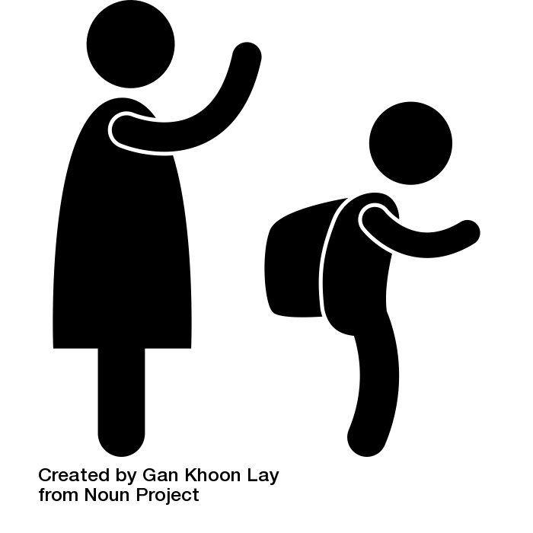
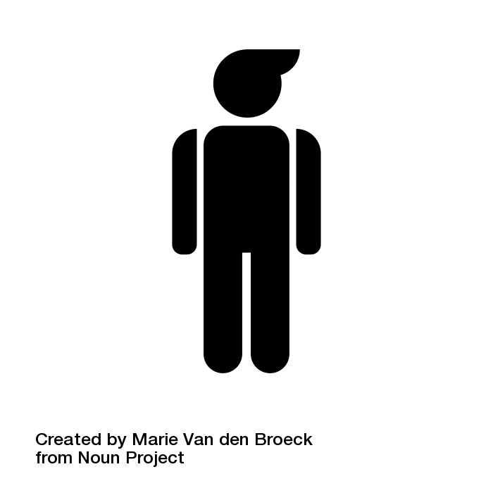


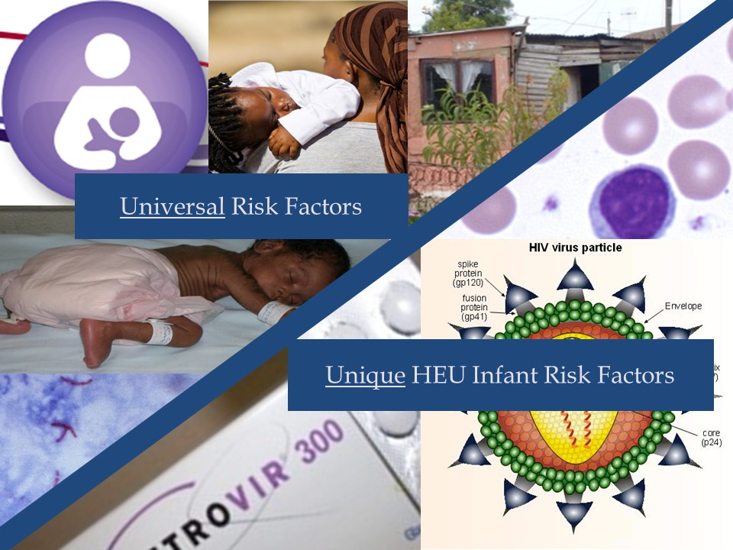

Start Free, Stay Free, AIDS Free –
Bridging the Gap
Notes:
HEU children have differing HIV viral exposure during gestation. For example, some HEU infants are born to women who enter pregnancy virally suppressed while others are exposed to incident HIV infection in utero.
Our current HEU adolescents are less likely to have been exposed to triple ARVs in utero compared with an infant born in the last year.
An infant born in the last year is likely to be exposed to a significantly different ARV regimen than an infant born 5 years ago, as more ARV options emerge.

Slide 32
Contributors
Elaine Abrams
Landon Myer
Mary Mahy
Lynne Mofenson
Amy Slogrove
George Seage III

